Slide 1
Free Now Application

Slide 2
Agenda
Application Dependencies
Folder Structure
Components
Design

Slide 3
Dependencies
The application uses mainly below mentioned libraries
Material UI libraries
libraries that implement Google's Material Design.
Axios
http client
Leaflet
Open source library for maps

Slide 4
Folder Structure
The root `Src` folder contains mainly below folders, file
Components
The folder contains all common components like DelayedLinearProgress, EmptyView, ErrorView.
Config
Contains Config.ts for all common configuration like server url
Hooks
Contains custom hooks defined for the application like useApiClient
Layout
Define the common layout of the application - AppLayout
Sidebar and header is defined
Lib
Contains all utility classes
Models
Contains all model classes used in application
Views
The folder contains the display components like dashboard, vehicle container
App Theme
Contains theme information for the application like primary, secondary, error, info, success color etc.

Slide 5
Routes
The app routes are defined in Routes.tsx
2 paths has been defined
‘/dashboard’ – for the home page
‘/vehicle’ – for the displaying the vehicle information
Based on the routes list, the sidebar menu is populated.

Slide 6
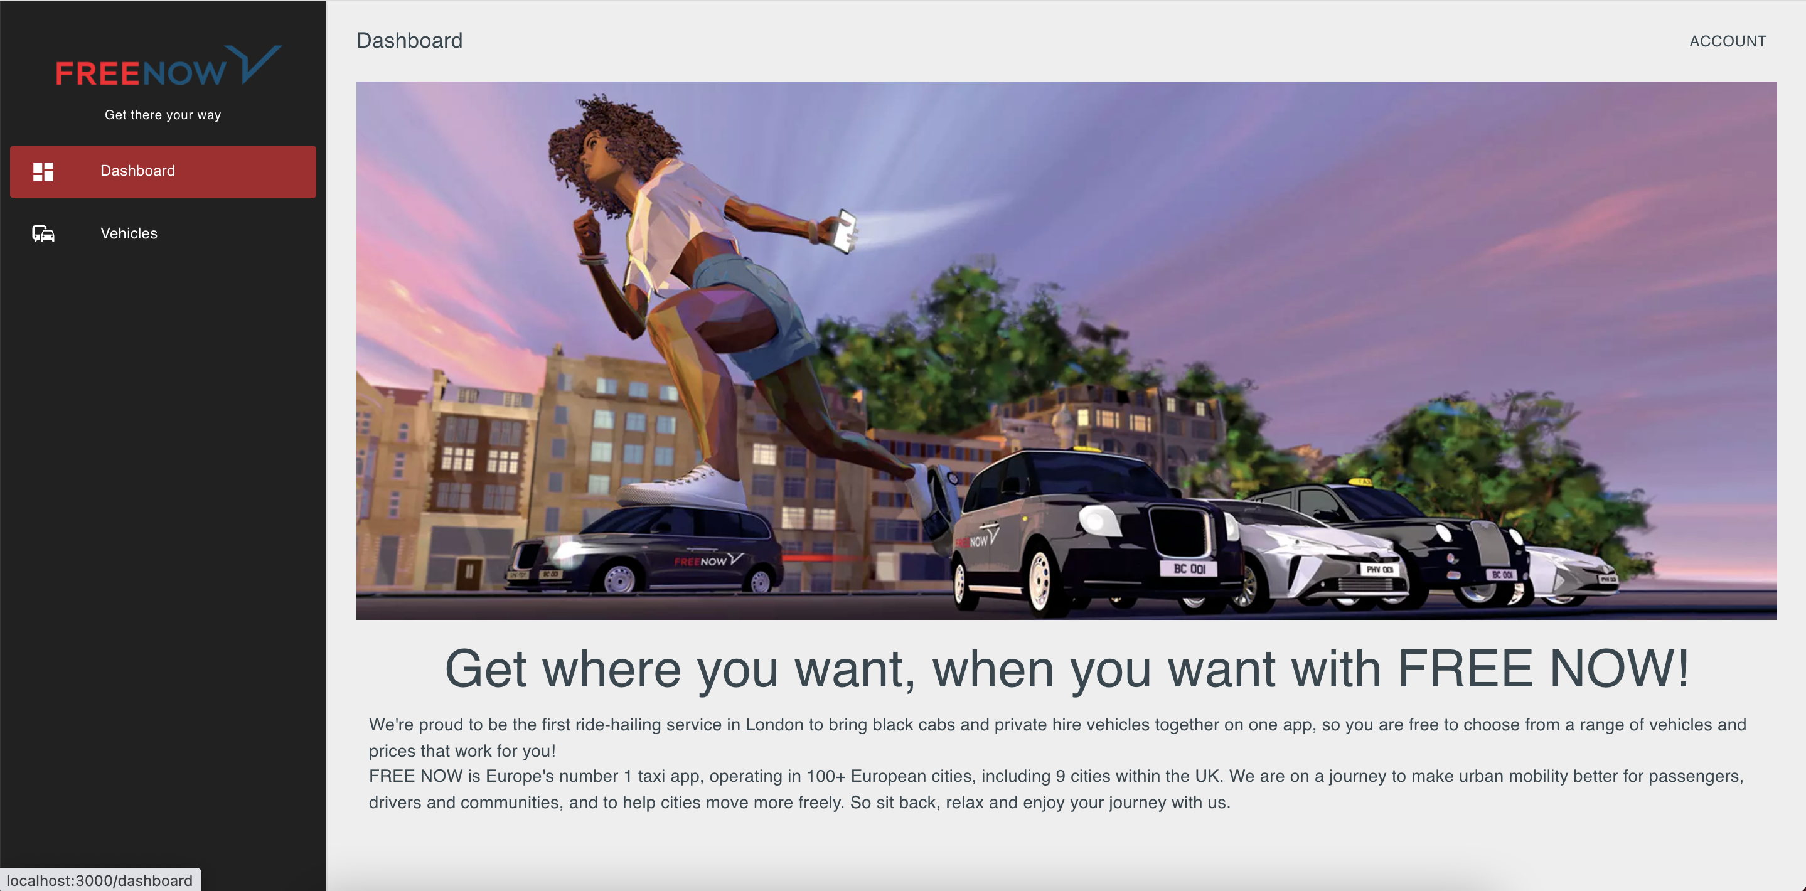
Dashboard Component
The component contains
Image
Description text

Slide 7
VehicleContainer Component
The container contains
The app bar to display the search options, count information and filter options
The list view to display all vehicles details in Vehicle Component
Location map to display the map along with vehicle details
Makes call to server(api) to get all vehicles details.
Custom hook - useApiClient is used here.
Once data is received, it is being passed to all sub-components – Vehicle, LocationMap

Slide 8
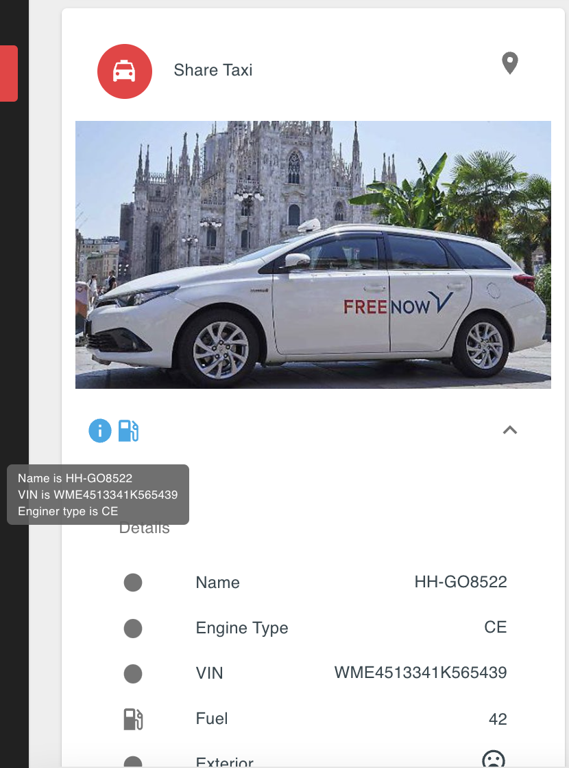
Vehicle Component
Each vehicle details is displayed using Vehicle Component
It uses Card component from Material UI to display the details
The title uses Avatar to display the car type.
Each icon displays the detail information using tooltip.

Slide 9
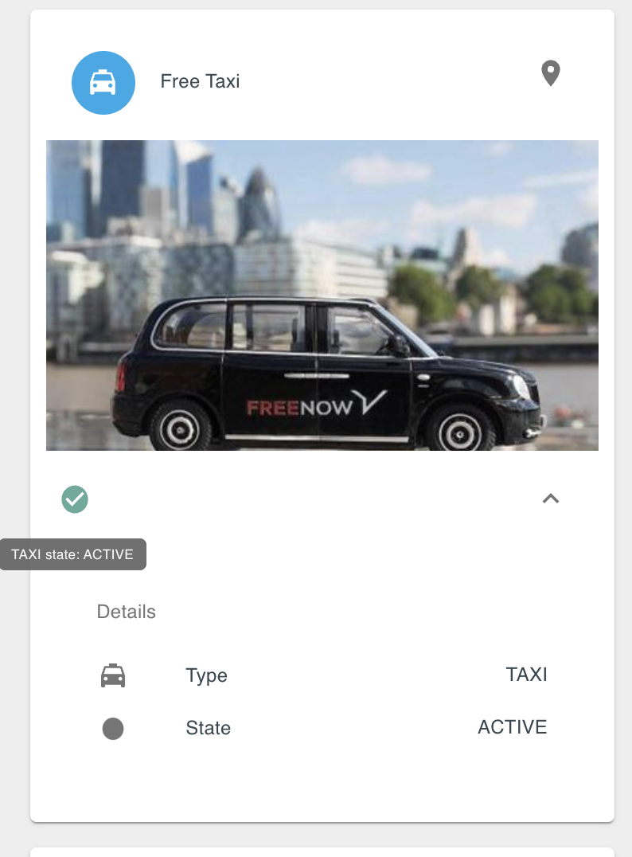
Vehicle Component Cont..
The top right corner contains the location icon which when clicked will highlight its position on Map on right hand side.
The car details are displayed under Card Content.
Exterior, Interior information is displayed using icon and tooltip is added for details information display

Slide 10
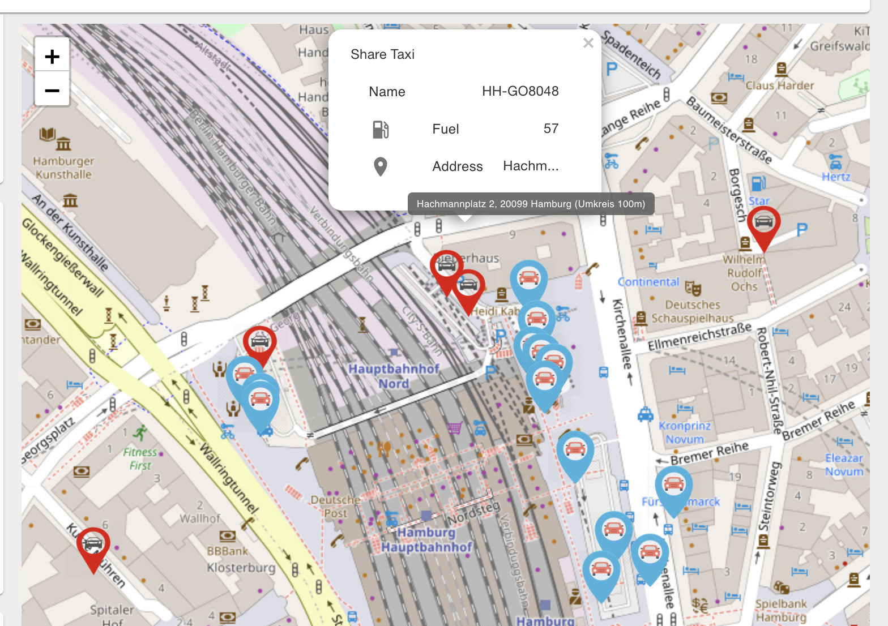
LocationMap Component
The component displays the Map.
It renders MapComponent from leaflet library
All displayed vehicles’ location are marked on the map.
Along with each marker, each vehicle details is also populated.
Different vehicle type are displayed by different color marker.
Blue for Free Now vehicles and Red for Share Now vehicles
Zoom-in/out can be performed to view the location in detail.

Slide 11
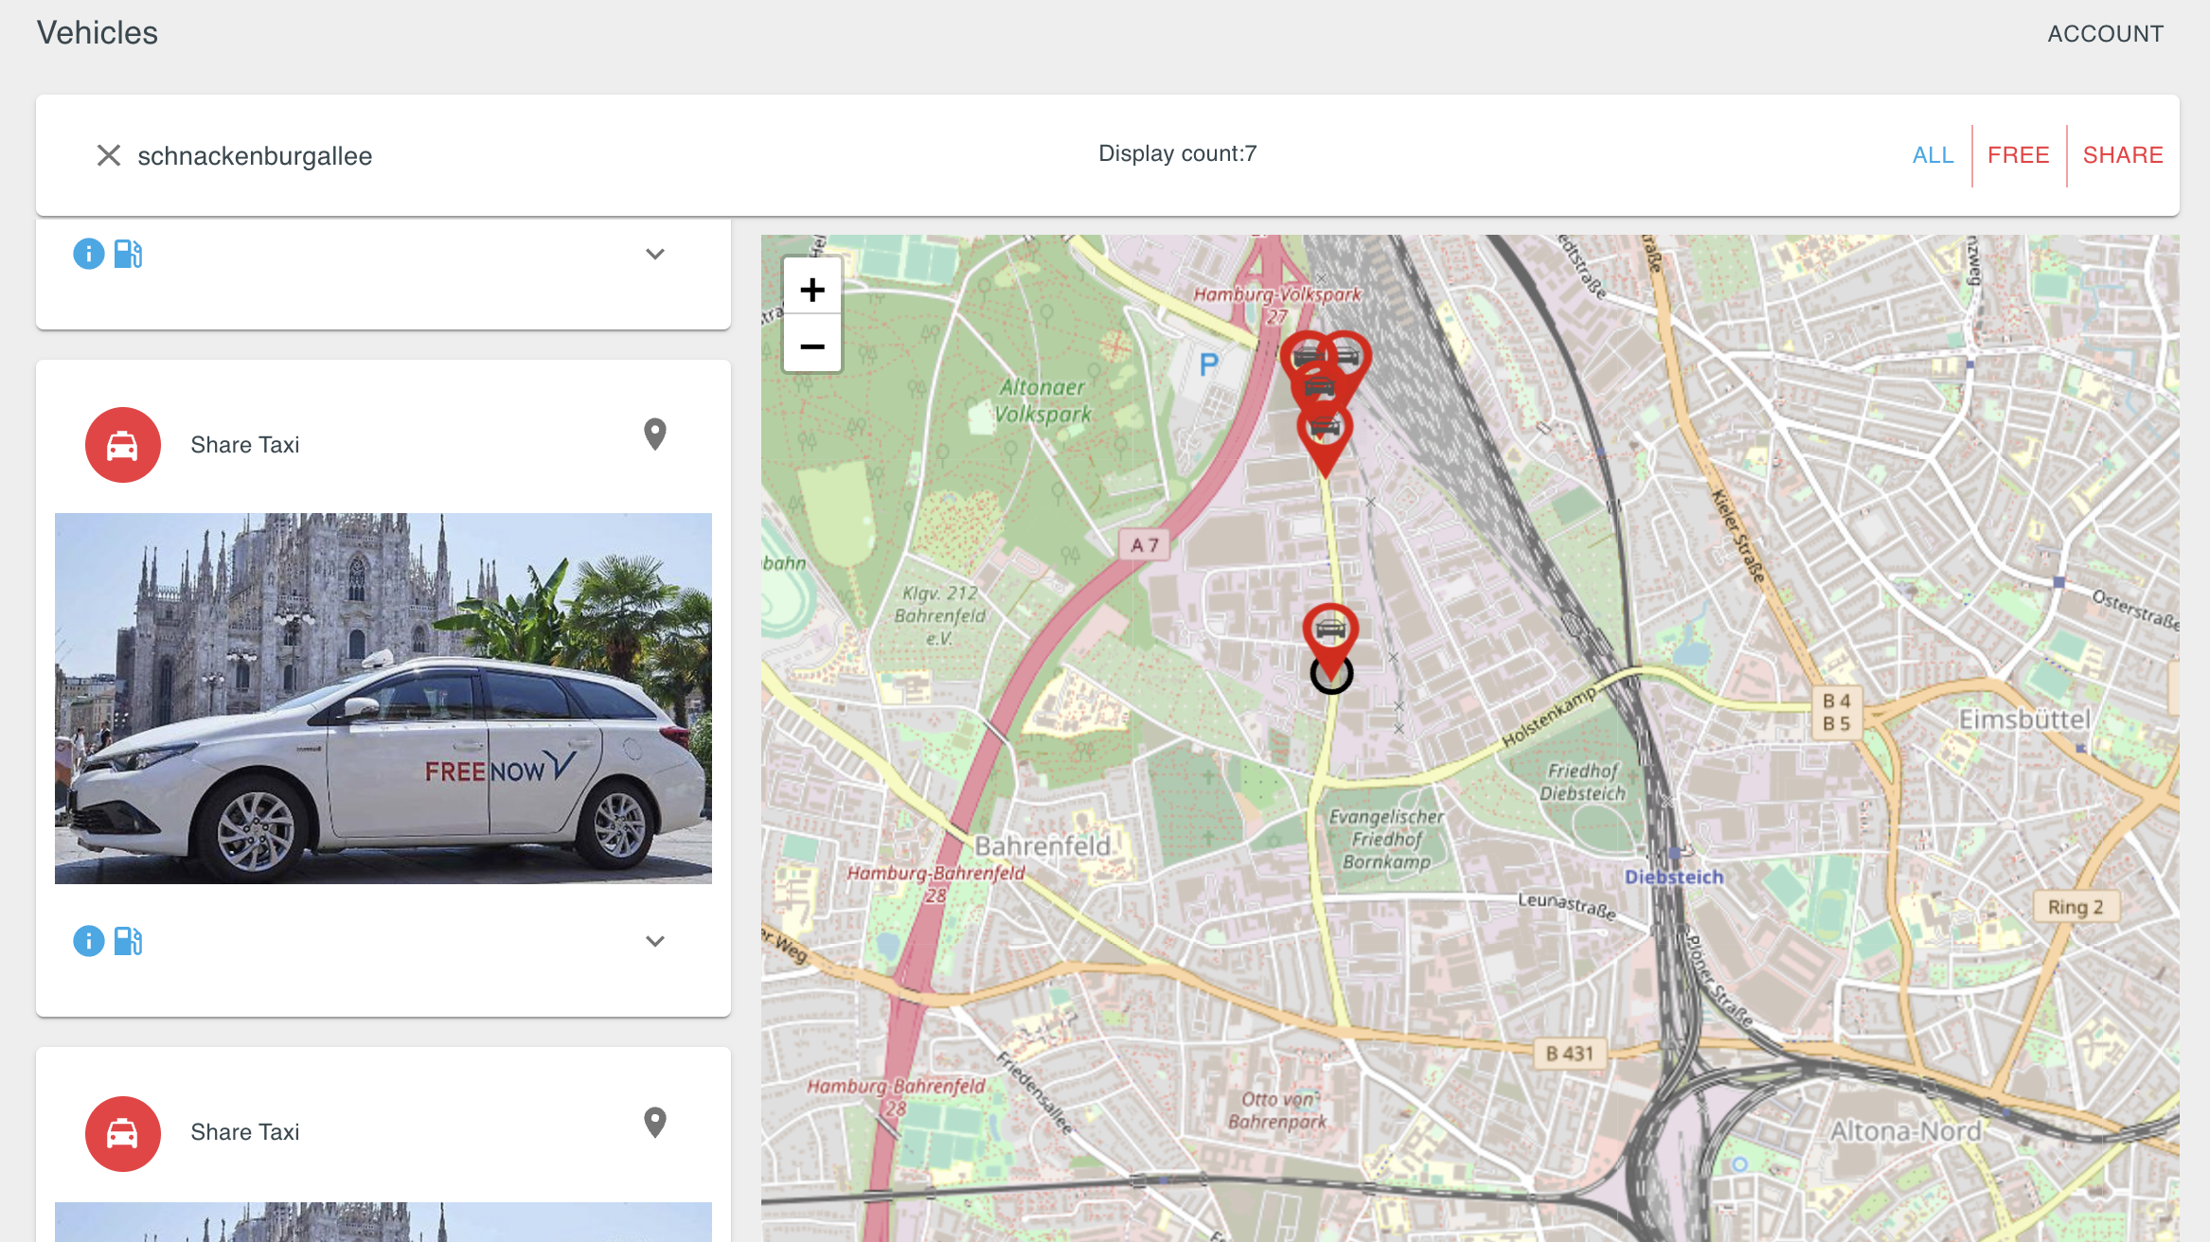
Supported features
Progress bar: will be displayed during data is being fetched from server
Search
Search functionality is supported to find vehicle(s) based on Vehicle’s name, VIN, Address and type
Based on search result, the vehicle will be displayed and corresponding location on Map.
Display count will display the vehicle count information

Slide 12
Supported features Cont..
Filter
The filter is supported to display particular type of vehicles – Free Now, Share Now, All
By default All filter is selected.
Based on filter, vehicles will be displayed in list and Map.
Search can be performed after filter is applied.
Display count will display the vehicle count information

